Slide 1
Mediterranean Climate.
Warm temperate Oceanic Climate.

Slide 2
Location
The Warm temperate climate is located between 30 and 40 degrees north and south of the Equator along the western sides of the continents.
It is called the Mediterranean Climate in Europe because it is found around the Mediterranean Sea.

Slide 3
Temperature
Summers are hot with temperatures averaging around 30 degrees.
The sun is high in the sky with very little cloud cover, making it very warm.
This is because high pressure covers the area in summer and the region is close to the Tropics.
Winters are mild with average temperatures of 15 degrees.

Slide 4
Rainfall.
Annual rainfall varies between 400 and 700mm.
Rain falls mostly in the winter because the prevailing wind that comes from the Atlantic Ocean is moist.
Summers are hot and dry because the prevailing winds blow over dry landmasses.

Slide 5
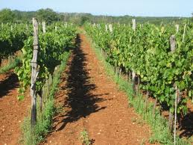
Soils.
The main soil found in the Mediterranean is Terra Rossa.
It is a red clay.
Due to its good drainage characteristics it is suited to vine growing for wine production.

Slide 6
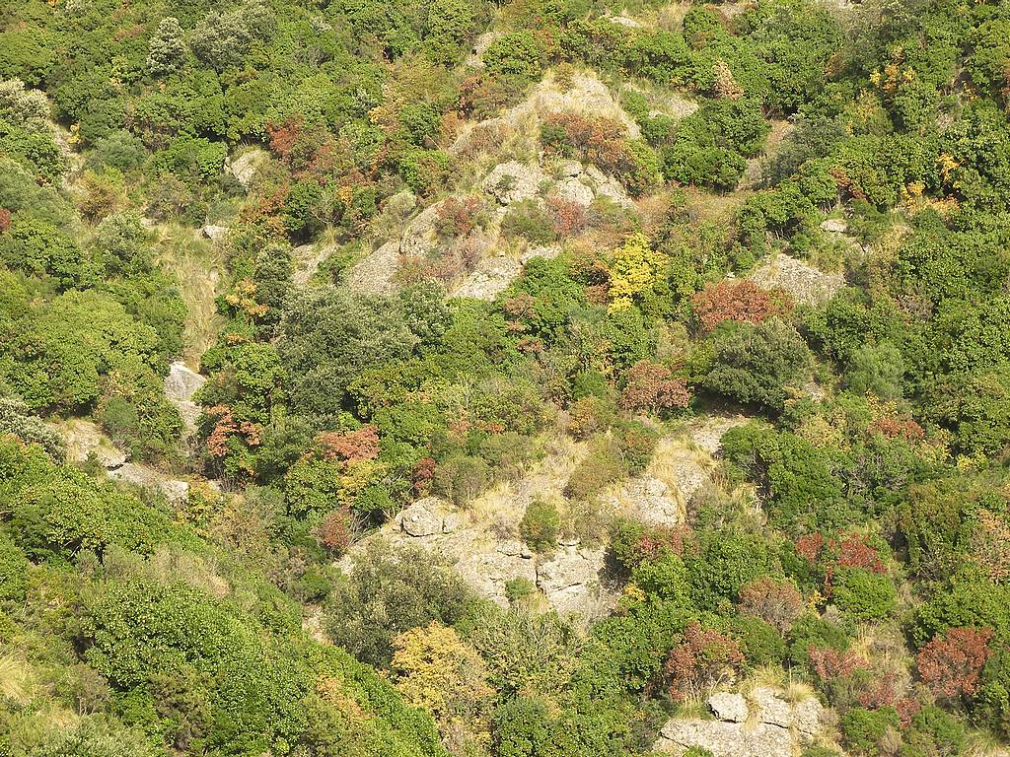
Natural vegetation.
The natural vegetation of the Mediterranean region is a type of scrub forest with trees such as cork oak, cypress and olive.
These trees absorb moisture during the winter.
Their thick barks and waxy leaves prevent moisture loss during the hot summers.
A rough scrub like vegetation called Garrigue is found in this region.

Slide 7
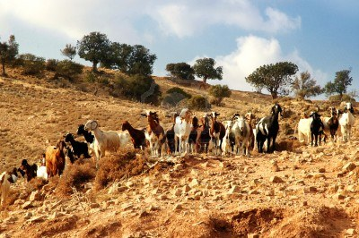
Animals.
Most of the natural woodland has been cleared.
Sheep and goats are reared in the region.

Slide 8
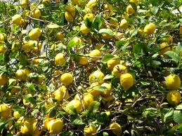
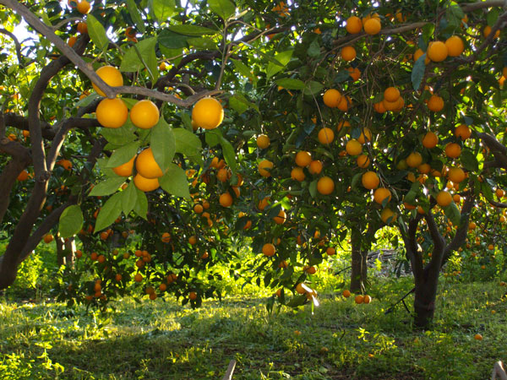
Human Activity.
Farming and tourism are the main economic activities.
Crops are grown all year round due to the mild winters.
Crops include vines, olives wheat and citrus fruit.
Overgrazing has resulted in the soil erosion in some areas.

Slide 9
Agriculture… human activities.
Large areas of woodland have been cleared for agriculture.
Irrigation schemes have been set up so as crops can grow in the summer droughts.
Pastoral farming is restricted to the rearing of sheep and goats. This has lead to overgrazing.
Due to long hours of sunshine and all year round growing season fruit (especially citrus) are grown throughout the year.
Due to irrigation new crops such wheat and maize have been introduced.
The Mediterranean has always been known for the cultivation of olives, grapes and citrus fruits because of the suitable climate.

Slide 10
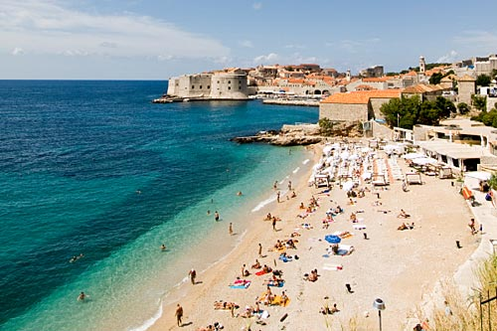
Human activity.
Tourists are attracted to the warm dry climate.
Resorts have developed along the coasts in response to this.
There are miles of sandy beaches and many beautiful coastal towns and cities to visit.
The warm summers attract cruise ships while the mild winters attract older tourists from Northern Europe.

Slide 11
Tourism…. Human Activities.
Tourism has many positive effects;
It brings wealth and an income source to rural areas that are isolated from the large urban centres.
Jobs are created in bars, restaurants, hotels and travel companies as well as in transport, souvenir production and building.
Transport links have been improved.
Negative effects have also been felt;
Employment is seasonal and many people are left without work for part of the year.
Services such as water supply and sewage are put under pressure in tourist season.
Visual pollution has been caused by bad planning and unattractive buildings being built in scenic areas.
Litter and the improper disposal of sewage have caused environmental damage.

